Slide 1
Programmable Interfacing Devices

Slide 2
General-Purpose Programmable Peripheral Devices
PPI – Programmable Peripheral Interface
It is an I/O port chip used for interfacing I/O devices with microprocessor.
Very commonly used programmable devices from Intel family are:
The 8255A peripheral interface.
The 8254 Interval Timer.
The 8294A Interrupt Controller.
The 8237 DMA controller.

Slide 3
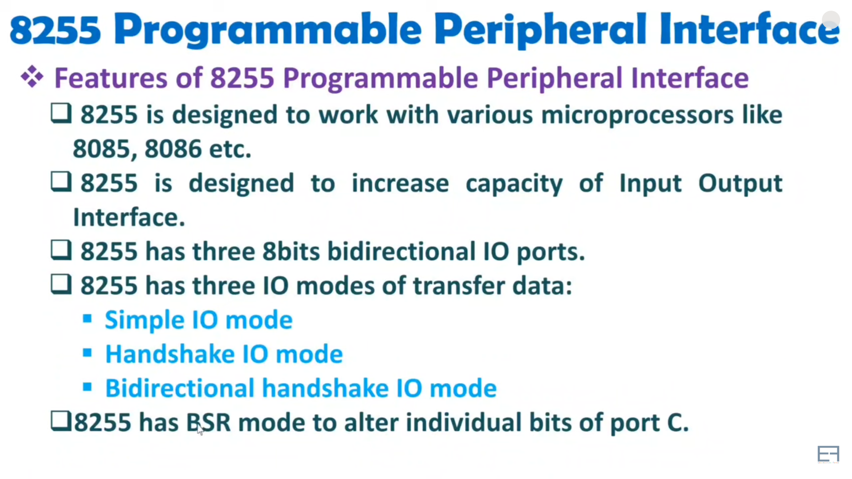

Slide 4
8255A Programmable Peripheral Interface
The 8255A is a general purpose programmable I/O device designed to transfer the data from I/O to interrupt I/O under certain conditions as required. It can be used with almost any microprocessor.
It consists of three 8-bit bidirectional I/O ports (24 I/O lines) which can be configured as per the requirement.

Slide 5
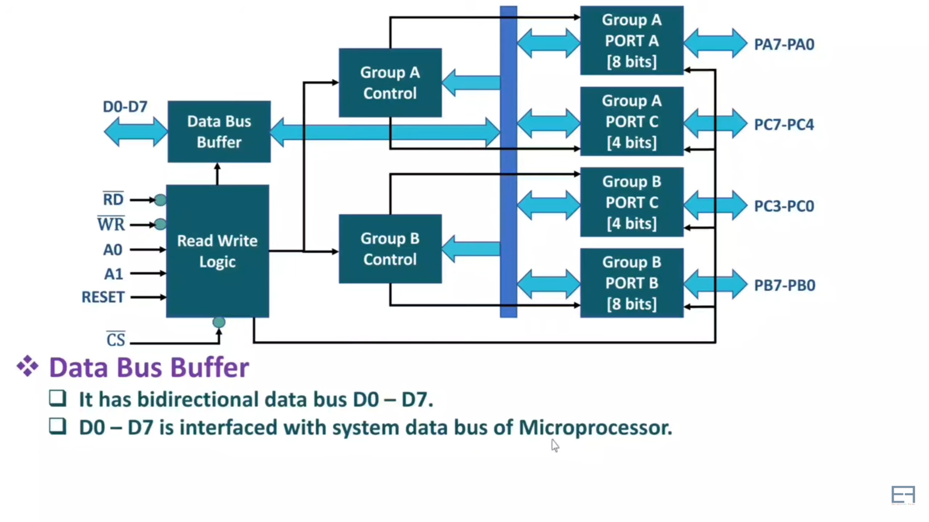

Slide 6
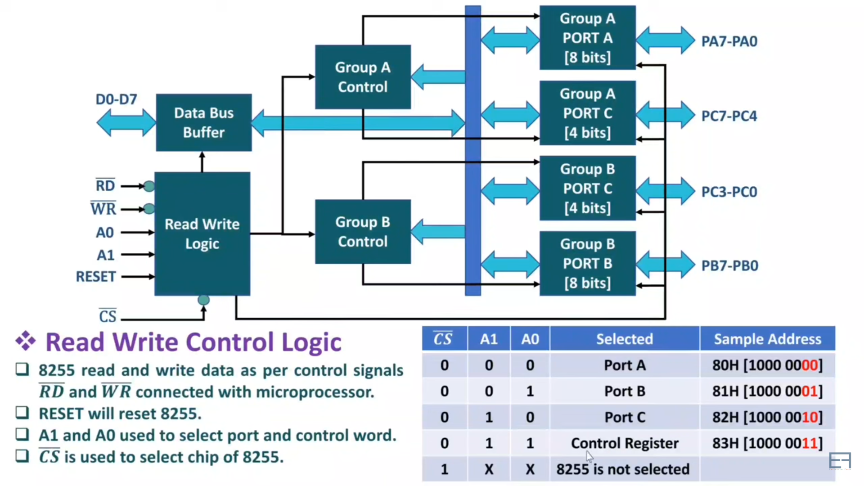
Read Write Control Logic of 8255

Slide 7
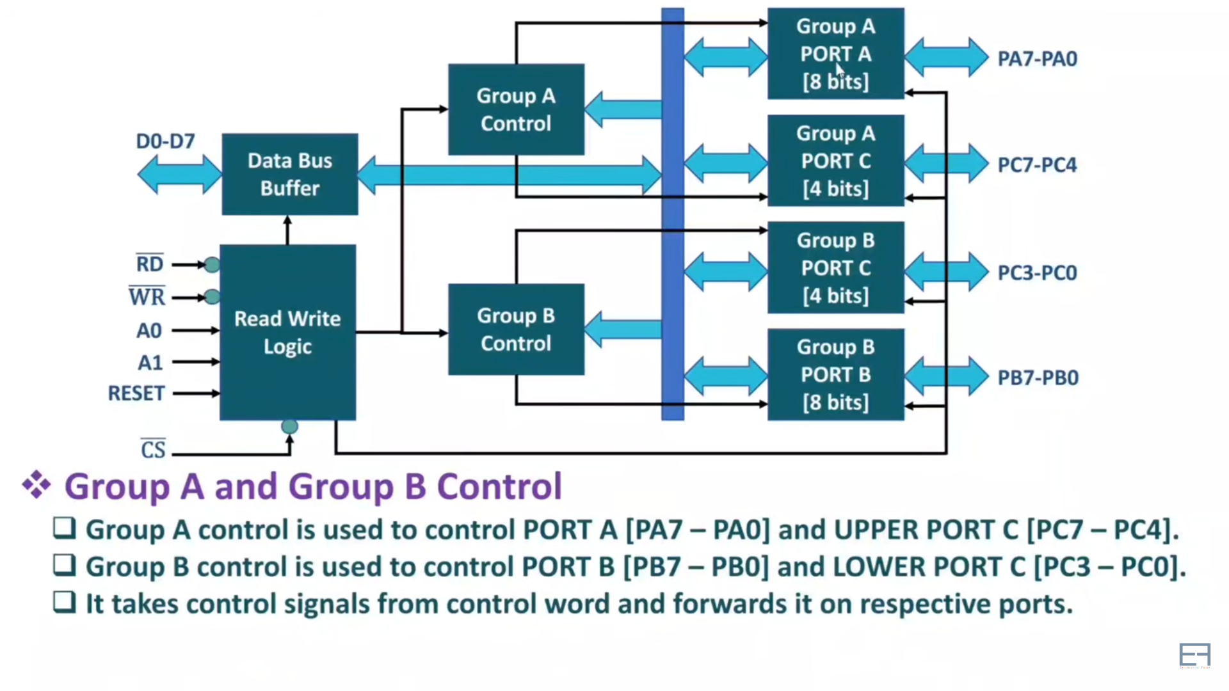
Group A & Group B Control of 8255

Slide 8
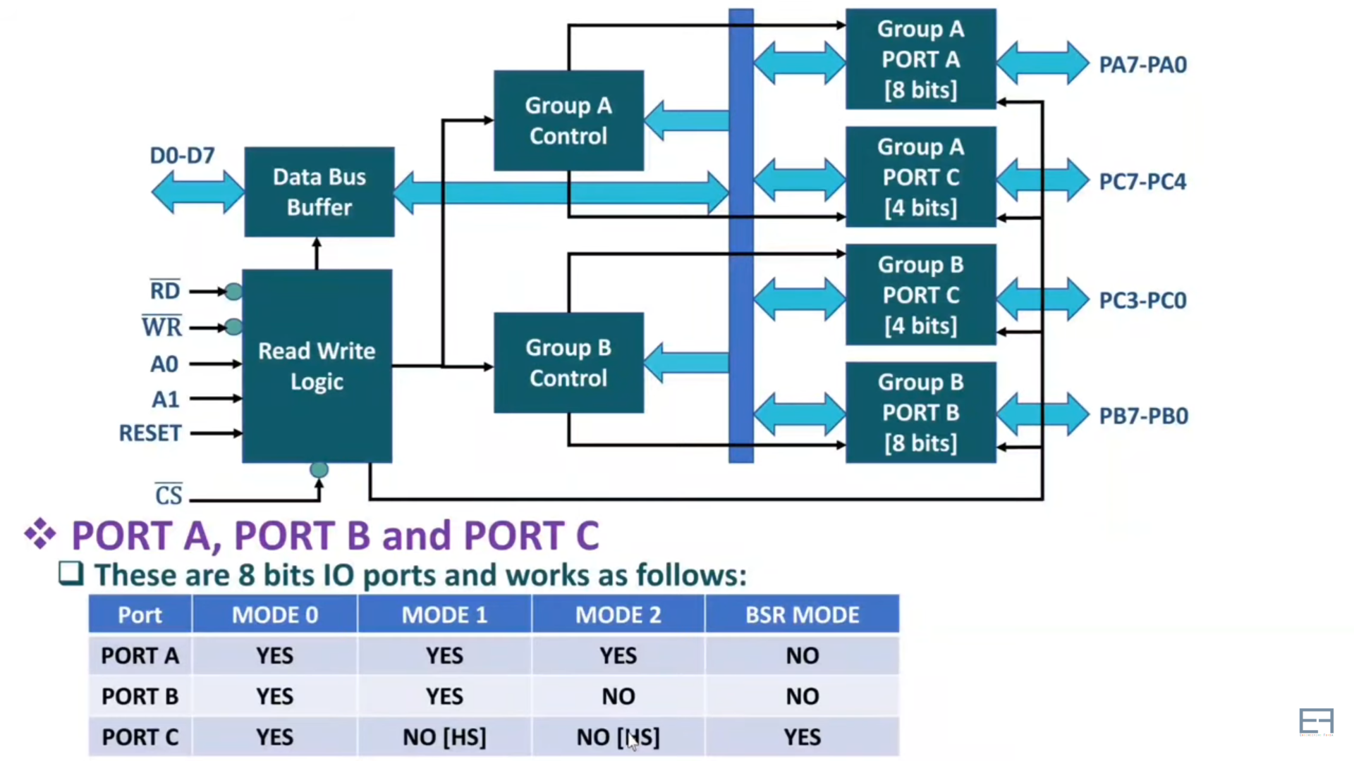
Ports of 8255

Slide 9
Ports of 8255A
8255A has three ports, i.e., PORT A, PORT B, and PORT C.
Port A contains one 8-bit output latch/buffer and one 8-bit input buffer.
Port B is similar to PORT A.
Port C can be split into two parts, i.e. PORT C lower (PC0-PC3) and PORT C upper (PC7-PC4) by the control word.
These three ports are further divided into two groups, i.e. Group A includes PORT A and upper PORT C. Group B includes PORT B and lower PORT C. These two groups can be programmed in three different modes, i.e. the first mode is named as mode 0, the second mode is named as Mode 1 and the third mode is named as Mode 2.

Slide 10
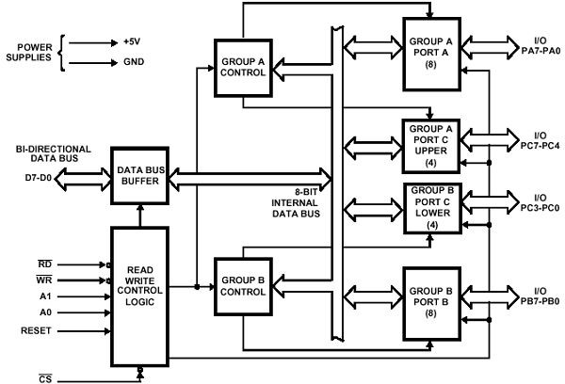
Block diagram of 8255

Slide 11
Different Mode of Operation of 8255
8255A has three different operating modes −
Mode 0 − In this mode, Port A and B is used as two 8-bit ports and Port C as two 4-bit ports. Each port can be programmed in either input mode or output mode where outputs are latched and inputs are not latched. Ports do not have interrupt capability.
Mode 1 − In this mode, Port A and B is used as 8-bit I/O ports. They can be configured as either input or output ports. Each port uses three lines from port C as handshake signals. Inputs and outputs are latched.
Mode 2 − In this mode, Port A can be configured as the bidirectional port and Port B either in Mode 0 or Mode 1. Port A uses five signals from Port C as handshake signals for data transfer. The remaining three signals from Port C can be used either as simple I/O or as handshake for port B.

Slide 12
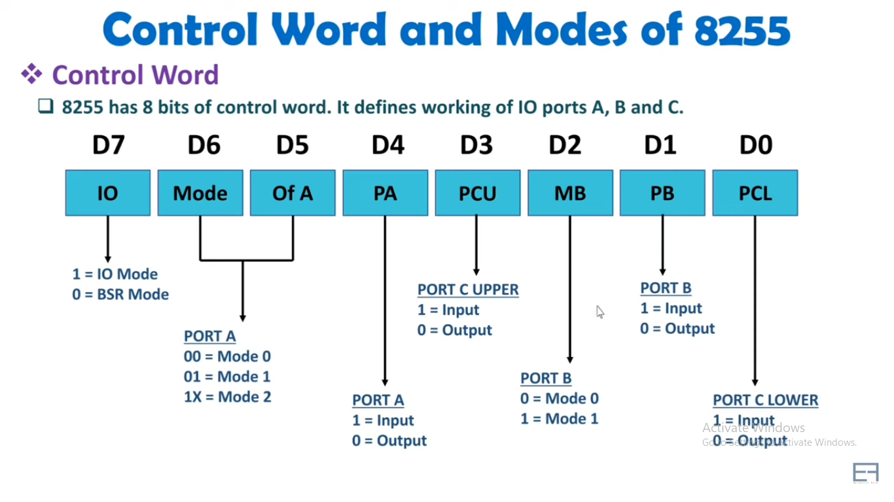
Nibble
Nibble

Slide 13
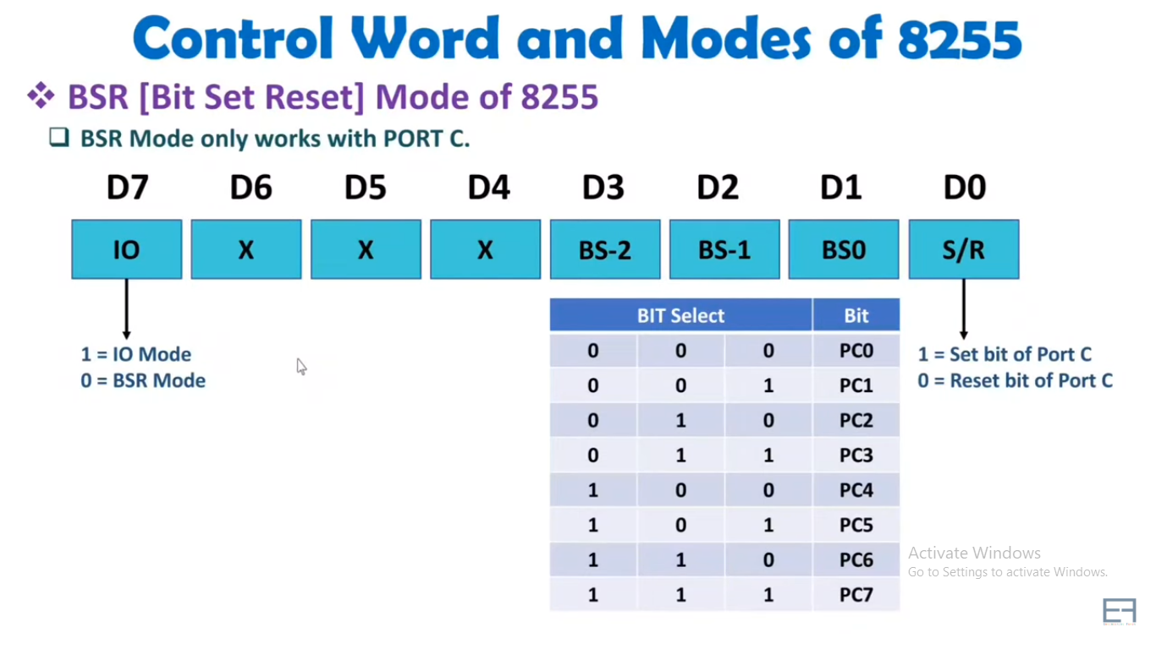
If the Terminal (PC0-PC7) values is 0/1 is selected by D0
D1, D2, D3 Is used to select individual terminal of port-C

Slide 14
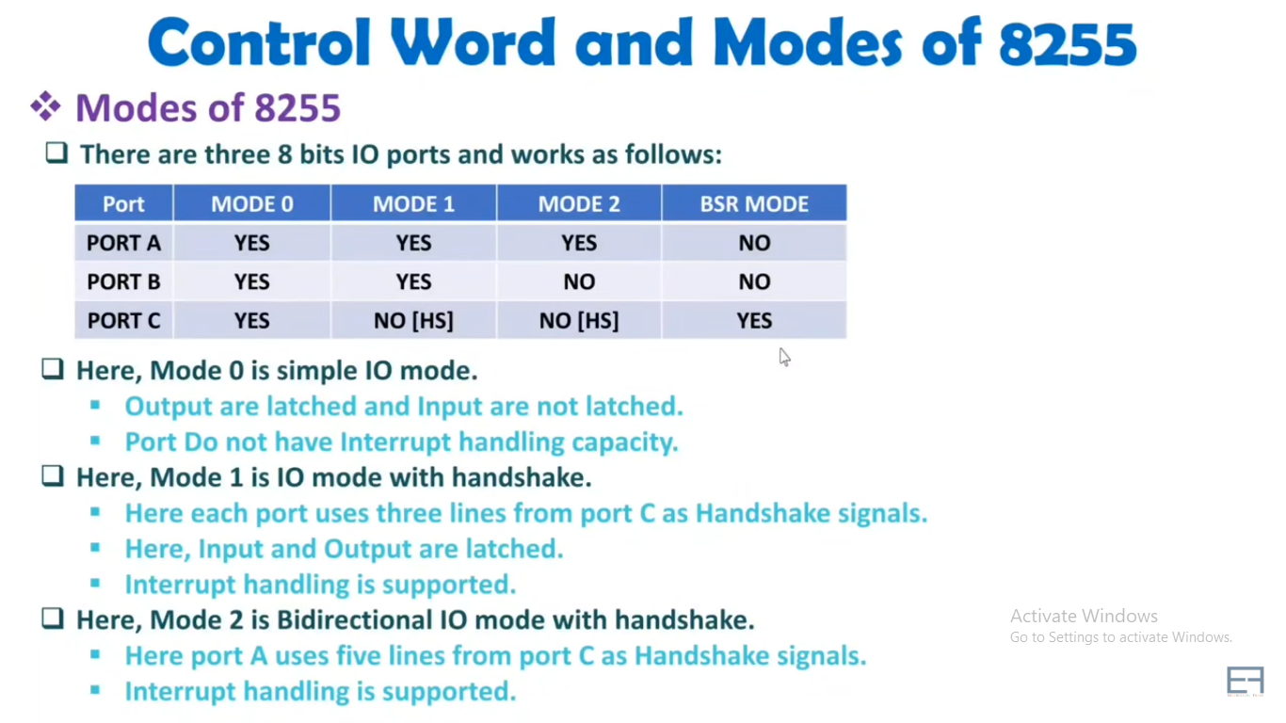
Works in handshaking mode

Slide 15
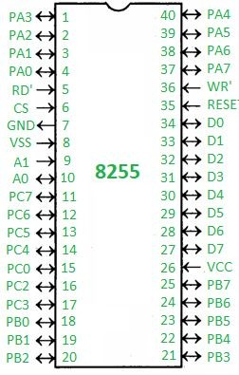
Pin Diagram of 8255
PA0 – PA7 – Pins of port A
PB0 – PB7 – Pins of port B
PC0 – PC7 – Pins of port C
D0 – D7 – Data pins for the transfer of data
RESET – Reset input
RD’ – Read input
WR’ – Write input
CS’ – Chip select
A1 and A0 – Address pins

Slide 16
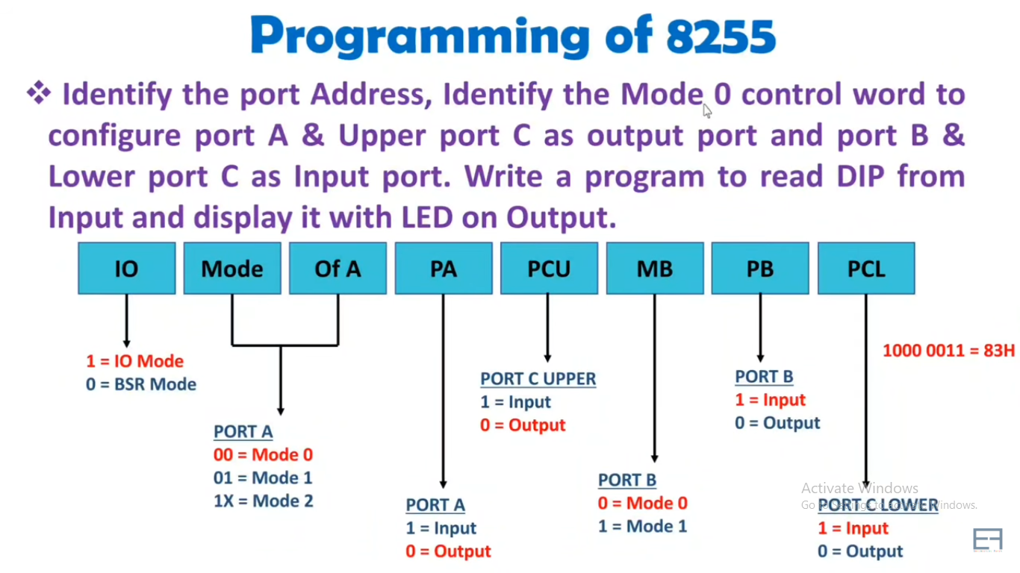
Problem
Control word for the problem below:

Slide 17
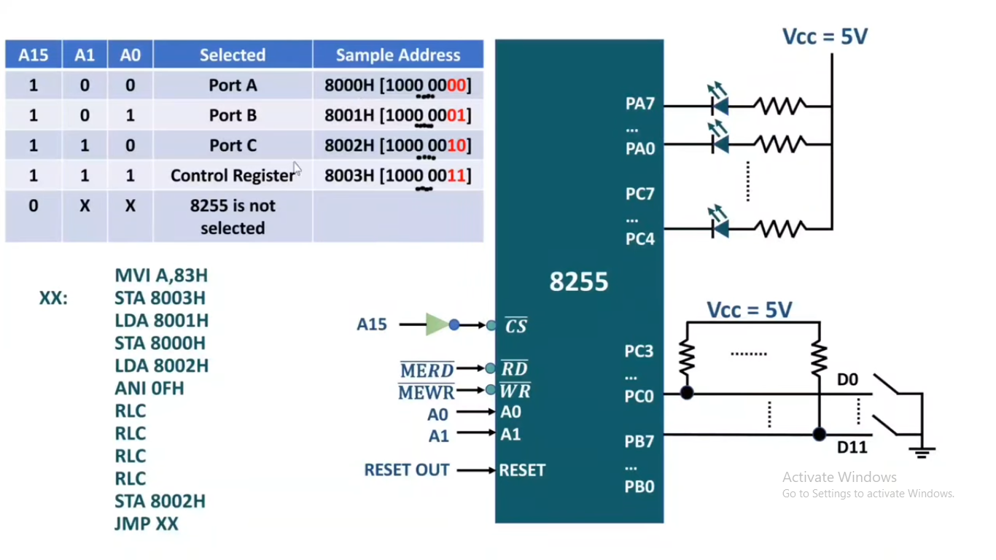
Interfacing, and Addressing Details
MVI=Move immediately ANI=Immediate addressing RLC=Rotate Left through Carry (Convert lower to upper nibble)

Slide 18
Interfacing A/D converter using 8255
To interface the ADC with 8085, we need 8255 Programmable Peripheral Interface chip with it.
The Port A of 8255 chip is used as the input port. The PC₇ pin of Port C_{upper} is connected to the End of Conversion (EOC) Pin of the analog to digital converter. This port is also used as input port. The C_{lower} port is used as output port. The PC₂₋₀ lines are connected to three address pins of this chip to select input channels. The PC₃ pin is connected to the Start of Conversion (SOC) pin and ALE pin of ADC 0808/0809.

Slide 19
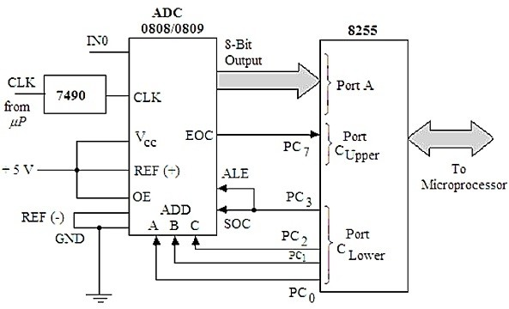
Interfacing A/D converter using 8255 (Cont.)

Slide 20
8253 Programmable Interval Timer
The Intel 8253 is Programmable Interval Timers (PTIs) designed for microprocessors to perform timing and counting functions using three 16-bit registers.
Each counter has 2 input pins, i.e. Clock & Gate, and 1 pin for “OUT” output.
To operate a counter, a 16-bit count is loaded in its register.
On command, it begins to decrement the count until it reaches 0, then it generates a pulse that can be used to interrupt the CPU.

Slide 21
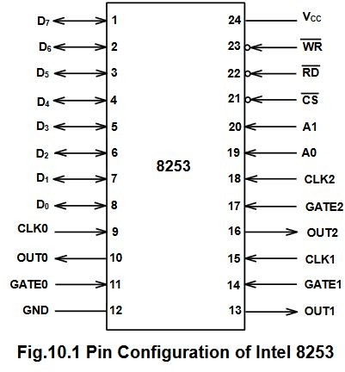

Slide 22
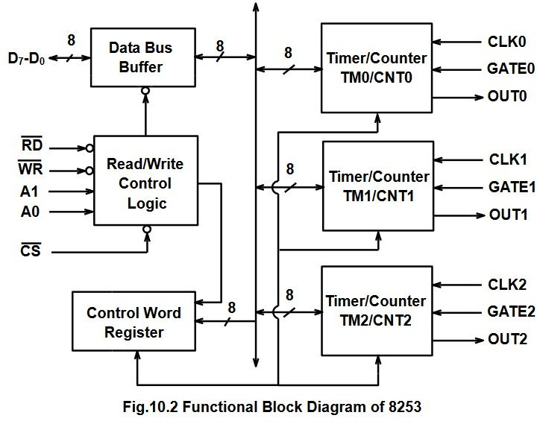

Slide 23
8259 Programmable Interrupt Controller
The 8259A is a programmable interrupt controller specially designed to work with Intel microprocessor 8080, 8085A, 8086, 8088.

Slide 24
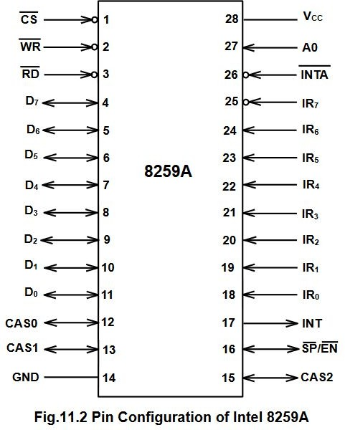

Slide 25
Modes of 8259A PIC
Fully Nested mode
Special Fully Nested mode
Nonspecific Rotating
Specific Rotating
Special Mask
Polling
Fixed priority mode

Slide 26
Fully nested mode:
This is a general purpose mode where all IR’s are arranged in highest to lowest.
IR0 highest and IR7 lowest.
Special Fully Nested Mode:
Used in more complicated systems.
Similar to, normal nested mode.
When an interrupt request from a certain slave is in service, this slave can further send requests to the master.
The master interrupts the CPU only.
Automatic Rotation Mode:
In this mode a device after being serviced receives the lowest priority.

Slide 27
Specific Rotation Mode:
In this user can select any IR for lowest priority thus fixing all priorities.
Special Mask Mode
When a mask bit is set in OCW, it inhibits further interrupts at that level and enables interrupt from other levels, which are not mastered.
Poll command
The INT output is neglected, though it functions normally by not connecting INT output or by masking INT input of the microprocessor.
This mode is entered by setting p=1 in OCW3.
A poll command may give more than 64 priority levels.

Slide 28
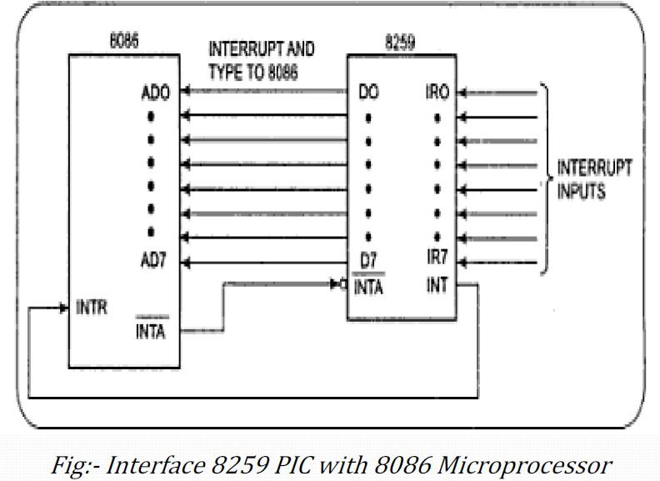

Slide 29
8257 DMA Controller
DMA stands for Direct Memory Access. It is designed by Intel to transfer data at the fastest rate. It allows the device to transfer the data directly to/from memory without any interference of the CPU.
Using a DMA controller, the device requests the CPU to hold its data, address and control bus, so the device is free to transfer data directly to/from the memory. The DMA data transfer is initiated only after receiving HLDA signal from the CPU.

Slide 30
Features of 8257
It has four channels which can be used over four I/O devices.
Each channel has 16-bit address and 14-bit counter.
Each channel can transfer data up to 64kb.
Each channel can be programmed independently.
Each channel can perform read transfer, write transfer and verify transfer operations.
It generates MARK signal to the peripheral device that 128 bytes have been transferred.
It requires a single phase clock.
Its frequency ranges from 250Hz to 3MHz.
It operates in 2 modes, i.e., Master mode and Slave mode.

Slide 31
